Slide 1
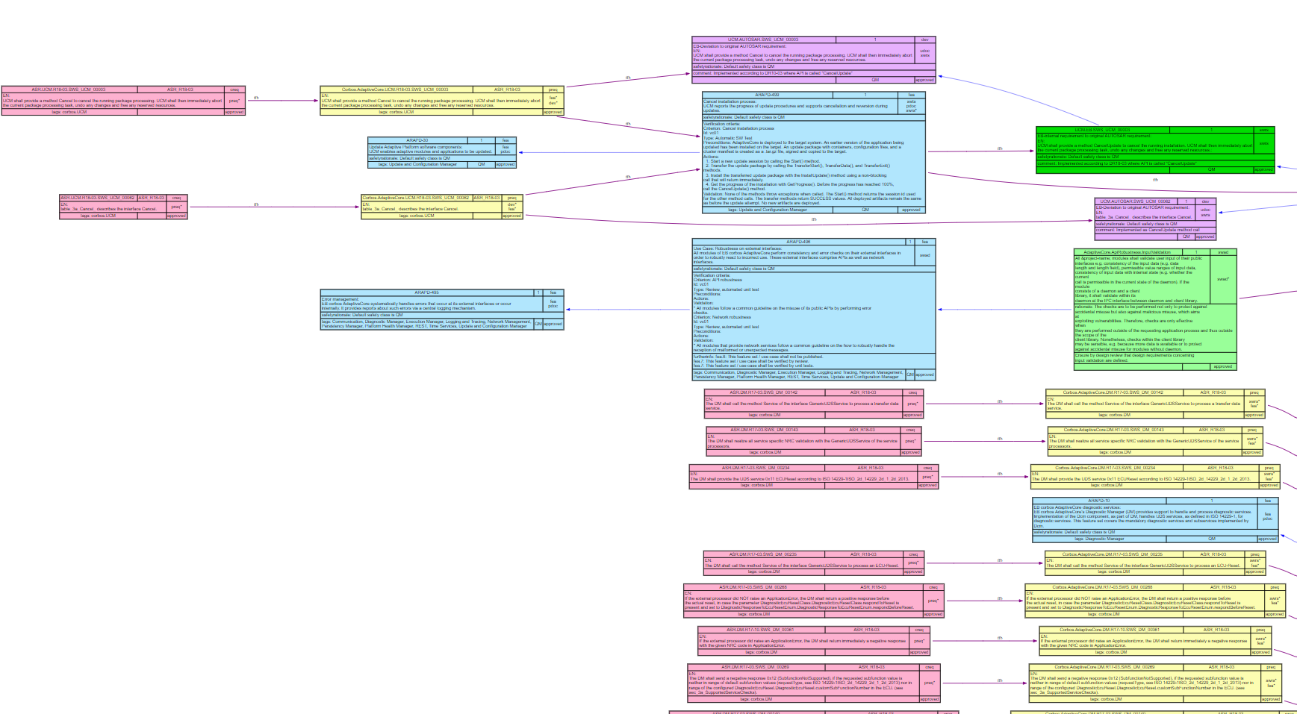
Visual ReqM2
Erling Stage 2020-07-13

Slide 2
What problem does it solve?
See relations between requirements at a glance with specobjecs color-coded by doctype.
Check if coverage relationships make sense and appear complete.
Find requirements with <id> or content matching search terms (regular expressions).
I.e. ask questions like: “do we have a requirement about ‘frobozz’?” and get a diagram of the context(s) it appears in.
When creating or modifying or checking requirements, Visual ReqM2 provides focused overviews in full depth.

Slide 3
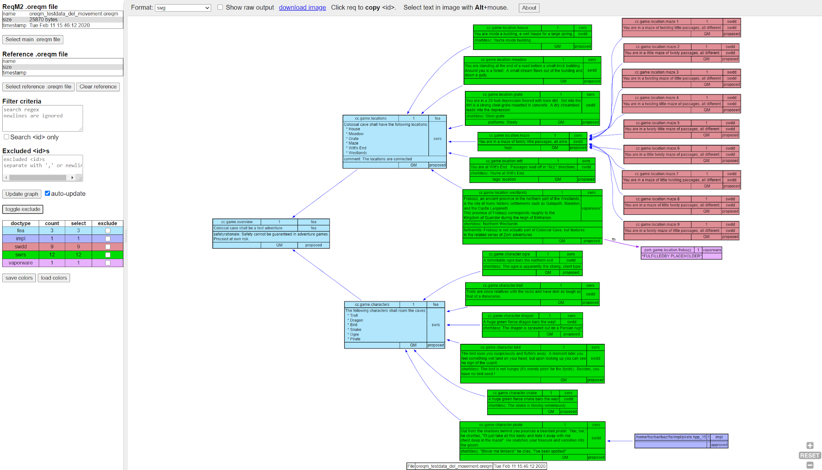

Slide 4
How does it work
A ReqM2 run creates the well-known html report, but also leaves behind an .oreqm file (which is XML using an expanded ReqM2 schema).
This .oreqm file contains all the information about the requirements.
Visual ReqM2 reads this file and creates relevant data structures, enabling search for requirements and efficient traversals of the coverage relations.
The output is a ‘dot’ graph with one or more specobjects found by search as well as the additional specobjects reachable by coverage, going both up and down the doctype hierarchy.
The ‘dot’ graph is rendered in your browser as a svg image

Slide 5
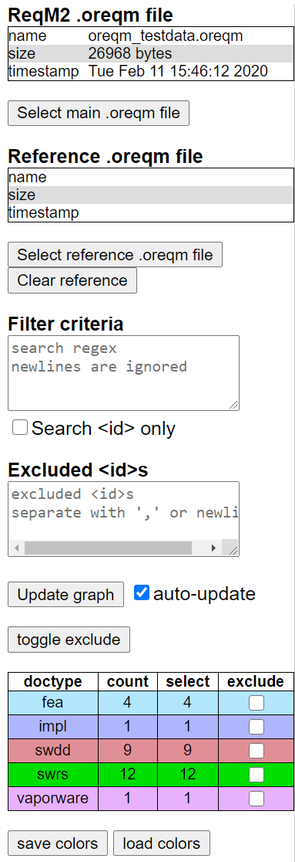
Selection of specobjects
An .oreqm file from a ReqM2 run.
Here is an overview of the selection logic in Visual ReqM2
When no filters are defined, the tool will show all specobjects.
This is often not desirable, as thousands of objects are not give a useful diagram.
When specobjecs are filtered, then identified specobjects and all reachable specobjects are shown.
This graph can be pruned by excluding specific <id>s or whole doctypes. The search for reachable specobjects will not traverse excluded <id>s or <id>s of excluded doctypes.
Optionally compare with another .oreqm file from a earlier ReqM2 run.
Regex match of specobject. This allows selecting multiple patterns using ‘|
Limit the search to <id> fields only
Exclude specific specobjects from the graph. This must be exact <id>s of specobjects
For small graphs (<150) elements auto-update is enabled.
For larger graphs a manual update is needed
Exclude specobjects of a certain doctype from the graph.
The JSON color palette can be controlled.
Each doctype has its own color boxes.

Slide 6
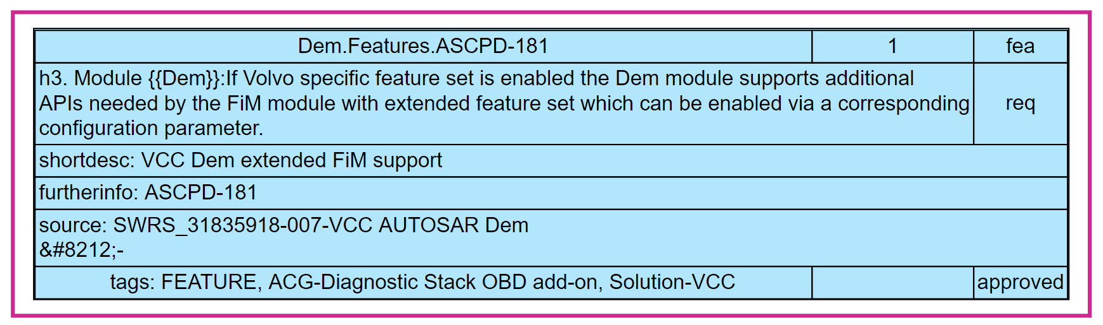
Reachable specobjects
Based on one of the search mechanism, a set of specobjects are selected.
These specobjects will be shown with a magenta outline in the graph. All coverage relations are shown for these nodes.
The tool performs graph walks from these initial nodes and further selects any reachable specobjects for display. Notice that these secondary specobjects may not have all their coverage relations shown.
Only the relations reachable from the selected specobjects are shown.
Tip: If all relations are wanted for a secondary specobject, change the search term to include it and re-generate the graph.

Slide 7
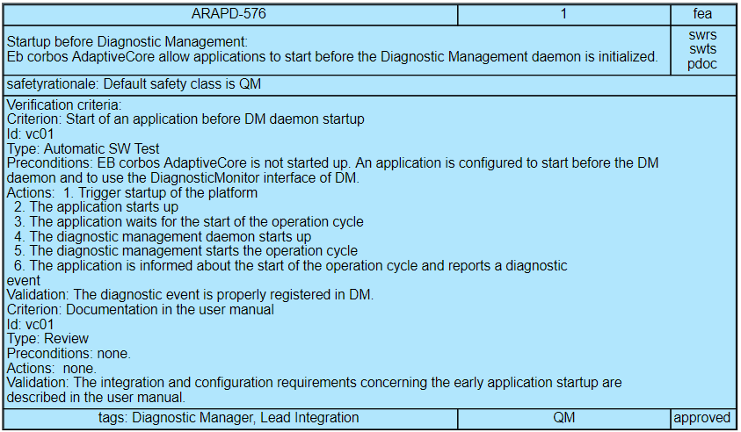
Display of the specobjects
The specobjects are rendered using the “html-like” table feature in Grahviz/dot.
Rich text attributes, as supported by docbook, are not supported by Graphviz, and the program only uses the data present in the .oreqm file.
The tool therefore removes docbook mark-up and hyperlinks from the text fields, such that the displayed text is readable. There are heuristics to keep lists recognizable as such.
Note: A basic design premise for this tool was to use the excellent (though not perfect) capabilities of Graphviz for rendering specobjects.

Slide 8
Specobject display layout
id
version
doctype
description
needsobj
Other labelled text fields
Other labelled text fields
Markup removed
status
tags & platform
safetyclass

Slide 9
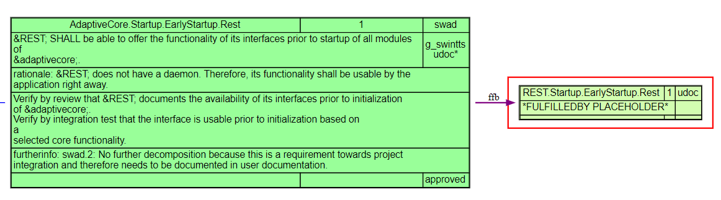
Fulfilled-by
There are a few tweaks in Visual ReqM2 related to fulfilledby coverage. The connecting edges are purple and have the legend ‘ffb’, to make them easier to spot.
In the list of needsobj doctypes, the doctype of the ffb relation(s) is added with an asterisk ‘*’ suffix, to give a clear picture of all expected coverage doctypes.
Placeholder specobjects are created for fulfilledby references, if the referenced requirement does not exist in the .oreqm file. Their description is “*FULFILLEDBY PLACEHOLDER*”
Pseudo needsobj

Slide 10
Visual ReqM2 Dependencies
Visual ReqM2 runs in modern browsers. It has been tested with Chrome and Firefox
Visual ReqM2 is written in javascript/HTML/CSS
It has been tested on both Linux and Windows.

Slide 11
Using the output
The generated svg can be downloaded by clicking the download image link.
The format can also be changed to png using the Format selection, and a right-click on graph allows png to be saved.
Zooming and panning is done with mouse wheel or scrolling gesture, around the mouse position.
Often the <id> of a requirement is needed to improve the filters. Clicking on a requirement copies the <id> on the clipboard, ready to paste into filter box.
Text in specobjects can be selected with mouse, but Alt key needs to be pressed. This is because of overlap with panning functionality using mouse drag.

Slide 12
Checking differences between .oreqm files
To review what happened with requirements between two releases or commits, the reference feature is useful.
When a reference file is specified, the new, changed and removed specobjects are the starting points for finding related requirements.
These specobjects will be outlined and all other related specobjects will be shown as well (see following slide).
The utility of this depends on the number of changes being ‘reasonable’. Here again excluding <id>s and doctypes may help.
Additional filters and exclusions can be added.
The reference file can be cleared again.

Slide 13
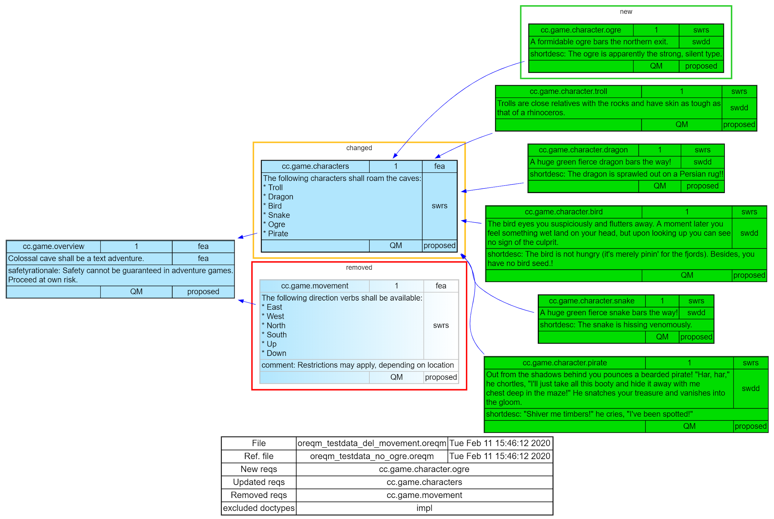
New requirement added
A requirement was changed
This ‘ghost’ is a removed requirement
The graph legend has a summary

Slide 14
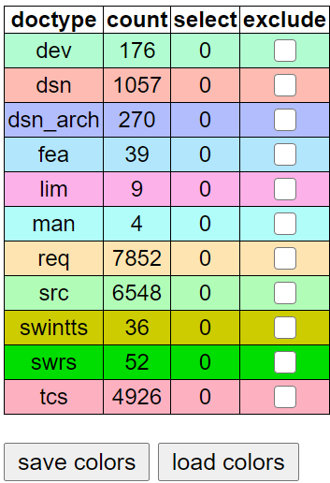
Color palettes
Visual ReqM2 will generate distinct colors for each separate doctype.
The tool has a predefined palette file. It generates pseudo-random pastel colors for new doctypes.
The palette can be exported as a simple JSON file with the “save colors” button.
Similarly a custom JSON can be loaded with “load colors” button.

